Slide 1


Oracle Database 12c Multitenant Architecture
Doyensys
DOYENSYS

Slide 2



Who Am I?
Hariprasath . R
About 6+ years using Oracle Database
Oracle9i Database Administrator Certified Professional
Oracle10g Database Administrator Certified Professional
Oracle11g Database Administrator Certified Professional
Oracle 10g Database RAC Certified Expert
.

Slide 3
Objective
Help you to get successfully started with Oracle Multitenant

Slide 4
Program Agenda
Oracle Multitenant Database Architecture
Overview of Multitenant : (CDB) & (PDB)
Multitenant : Create and Configure a (CDB) & (PDB)
Multitenant : Startup and Shutdown (CDB) & (PDB)
Multitenant : Manage Users and Privileges
Multitenant :Cloning pluggable database
Multitenant : Backup and Recovery (CDB) & (PDB)
Multitenant : Migrate a (Non-CDB) to a (PDB)

Slide 5
Oracle Multitenant Database Architecture
Oracle Database 12c offers a new option called Oracle Multitenant that enables to do just that. It offers simplified consolidation that requires no changes to your applications.
Main database contains oracle metadata of all tenant database.
All tenant databases contain user data.
Single instance would be shared by all tenant databases.
Main database called as CDB(container database)
Tenant database called as PDB(pluggable database)
Shared SGA and PGA
Single set of background processes
Let's see how the benefits of Oracle Multitenant stack up against your current database architecture

Slide 6

Oracle Multitenant Database Architecture

Slide 7
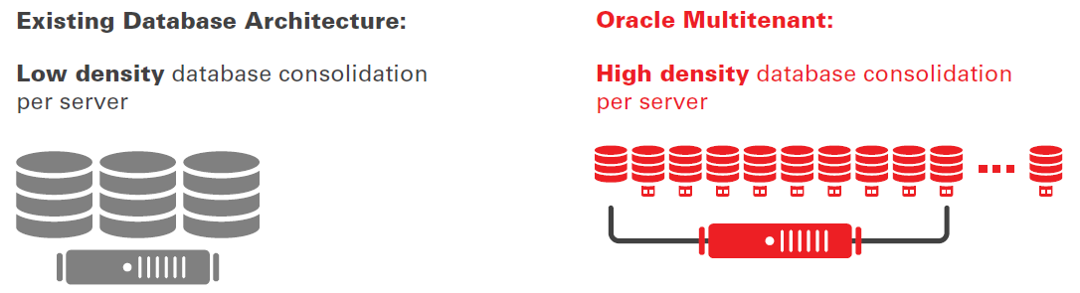
Oracle Multitenant Database Architecture
INCREASE SERVER UTILIZATION

Slide 8
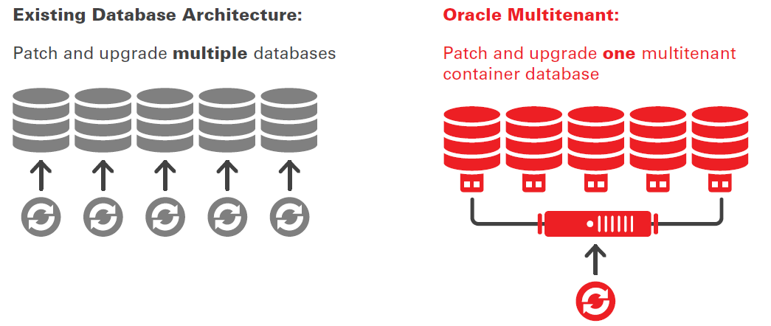
Oracle Multitenant Database Architecture
MANAGE MANY DATABASES AS ONE

Slide 9
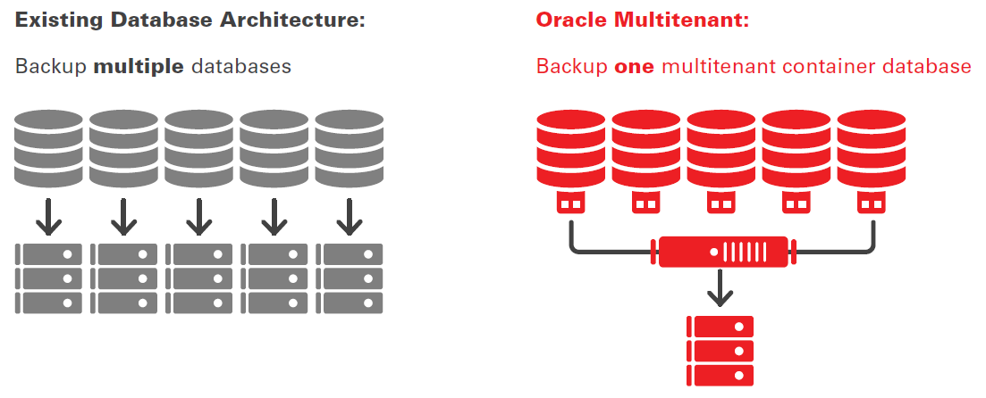
Oracle Multitenant Database Architecture
BACKUP MANY DATABASES AS ONE

Slide 10
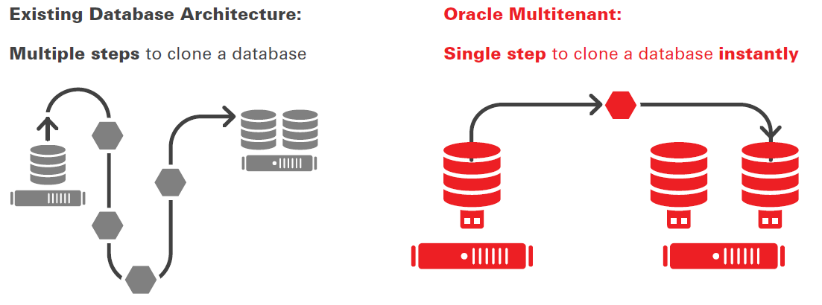
Oracle Multitenant Database Architecture
PROVISION DATABASES RAPIDLY

Slide 11
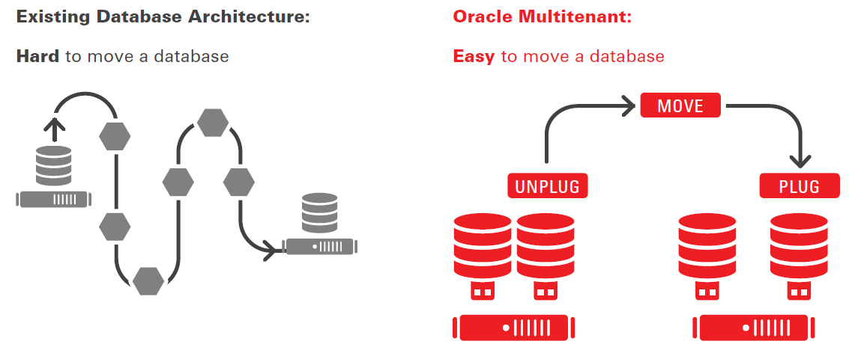
Oracle Multitenant Database Architecture
MOVE DATABASES RAPIDLY

Slide 12
Program Agenda
Oracle Multitenant Database Architecture
Overview of Multitenant : (CDB) & (PDB)
Multitenant : Create and Configure a (CDB) & (PDB)
Multitenant : Startup and Shutdown (CDB) & (PDB)
Multitenant : Manage Users and Privileges
Multitenant :Cloning pluggable database
Multitenant : Backup and Recovery (CDB) & (PDB)
Multitenant : Migrate a (Non-CDB) to a (PDB)

Slide 13
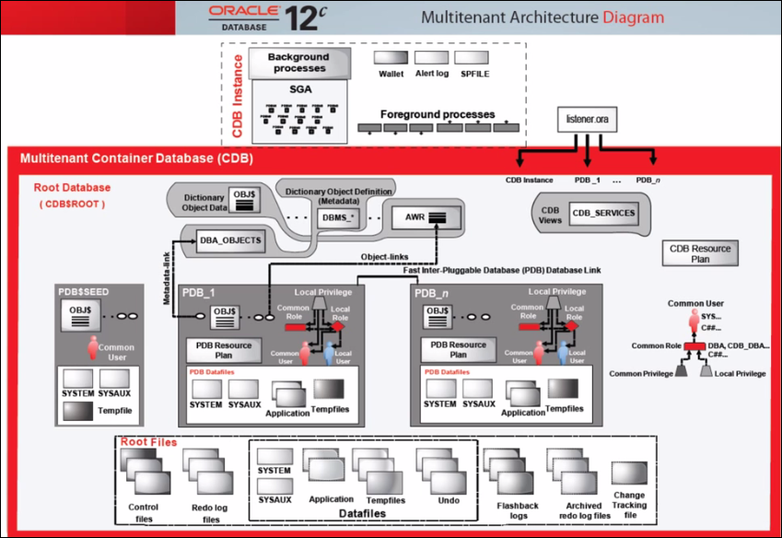
Overview of Multitenant : (CDB) & (PDB)

Slide 14
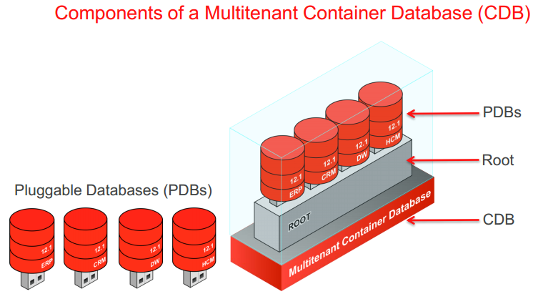
Overview of Multitenant : (CDB) & (PDB)

Slide 15
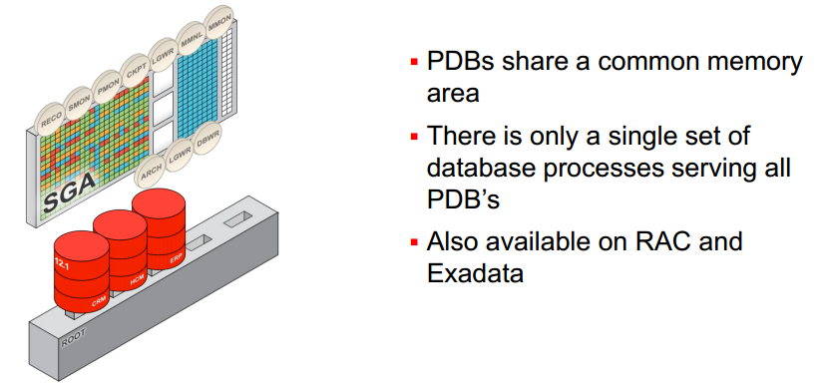
Overview of Multitenant : (CDB) & (PDB)

Slide 16
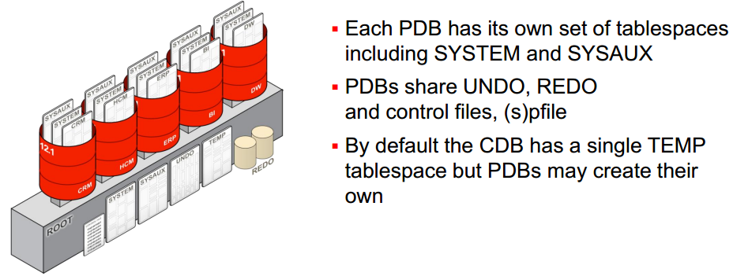
Overview of Multitenant : (CDB) & (PDB)

Slide 17
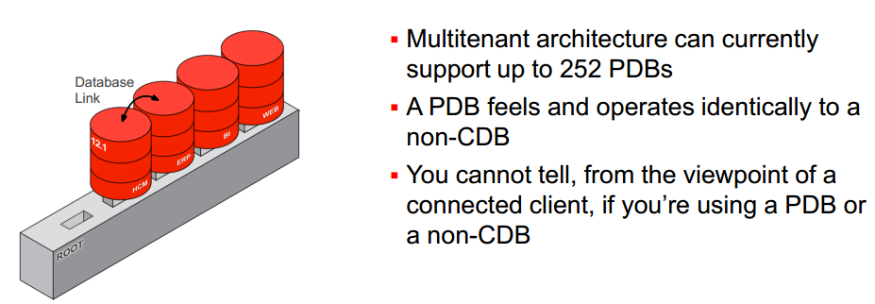
Overview of Multitenant : (CDB) & (PDB)

Slide 18
Program Agenda
Oracle Multitenant Database Architecture
Overview of Multitenant : (CDB) & (PDB)
Multitenant : Create and Configure a (CDB) & (PDB)
Multitenant : Startup and Shutdown (CDB) & (PDB)
Multitenant : Manage Users and Privileges
Multitenant :Cloning pluggable database
Multitenant : Backup and Recovery (CDB) & (PDB)
Multitenant : Migrate a (Non-CDB) to a (PDB)

Slide 19
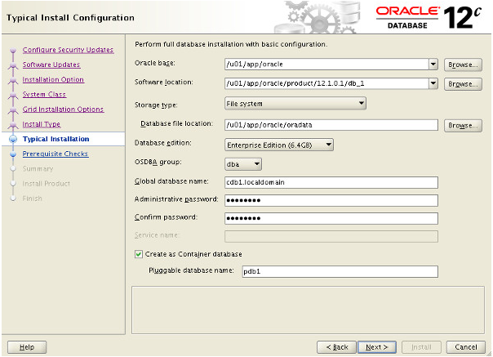
Create and Configure a (CDB) & (PDB) Databases
Oracle Universal Installer (OUI)

Slide 20
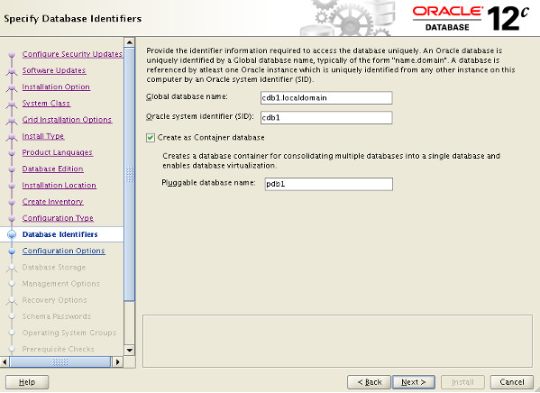
Create and Configure a (CDB) & (PDB) Databases
Advanced configuration options(OUI)

Slide 21
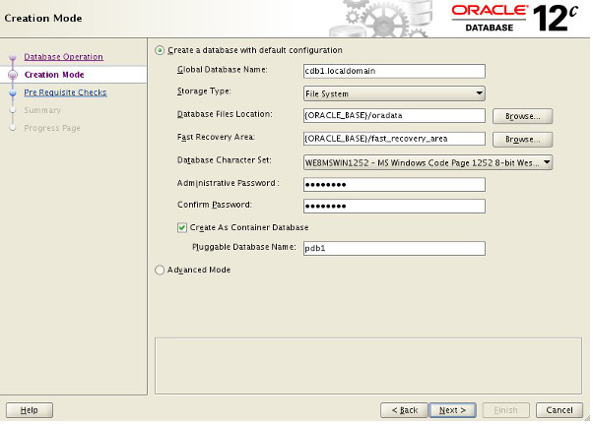
Create and Configure a (CDB) & (PDB) Databases
Database Configuration Assistant (DBCA)

Slide 22
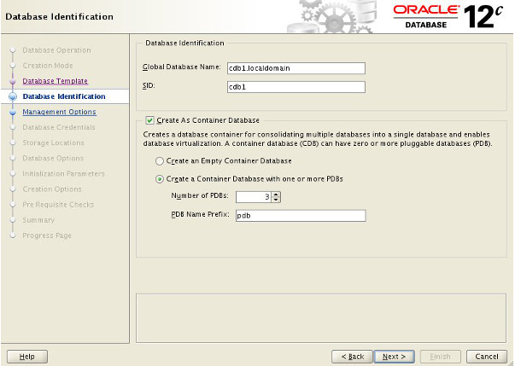
Create and Configure a (CDB) & (PDB) Databases
Database Configuration Assistant (DBCA)

Slide 23
Create and Configure a (CDB) & (PDB) Databases
Manual Creation
Creating CDB using CREATE DATABASE
The CREATE DATABASE command is almost the same
ENABLE PLUGGABLE DATABASE clause must be used
SEED FILE_NAME_CONVERT clause (only if not using OMF)
DB_CREATE_FILE_DEST initialization parameter if using OMF
or
PDB_FILE_NAME_CONVERT initialization parameter

Slide 24
Create and Configure a (CDB) & (PDB) Databases
CREATE DATABASE without OMF
SQL> CREATE DATABASE acdb
USER SYS IDENTIFIED BY ORACLE
USER SYSTEM IDENTIFIED BY ORACLE
….
ENABLE PLUGGABLE DATABASE SEED FILE_NAME_CONVERT = ('/u01/app/oracle/oradata/acdb/', '/u01/app/oracle/oradata/pdbseed/') SYSTEM DATAFILES SIZE 300M AUTOEXTEND ON NEXT 10M MAXSIZE UNLIMITED SYSAUX DATAFILES SIZE 200M USER_DATA TABLESPACE usertbs DATAFILE '/u01/app/oracle/oradata/pdbseed/usertbs01.dbf' SIZE 200M REUSE AUTOEXTEND ON MAXSIZE UNLIMITED;
SQL> @?/rdbms/admin/catcdb.sql

Slide 25
Create and Configure a (CDB) & (PDB) Databases
CREATE DATABASE with OMF
SQL> CREATE DATABASE acdb
USER SYS IDENTIFIED BY ORCL
USER SYSTEM IDENTIFIED BY ORCL
EXTENT MANAGEMENT LOCAL
DEFAULT TABLESPACE users
DEFAULT TEMPORARY TABLESPACE temp
UNDO TABLESPACE undotbs1
ENABLE PLUGGABLE DATABASE
SEED
SYSTEM DATAFILES SIZE 300M AUTOEXTEND ON NEXT 10M MAXSIZE UNLIMITED SYSAUX DATAFILES SIZE 200M;
SQL> @?/rdbms/admin/catcdb.sql*

Slide 26
Create and Configure a (CDB) & (PDB) Databases
Data Dictionary Changes
CDB_*
–Dictionary views showing data from Root and all Pluggable databases
DBA_*
−Dictionary views showing data from a container or from Pluggable databases
ALL_*
–Dictionary views showing data accessible by a users
USER_*
−Dictionary views showing data owned by a user
SELECT table_name FROM dict WHERE table_name like 'DBA%';
SELECT view_name FROM dba_views WHERE view_name like 'CDB%';

Slide 27
Program Agenda
Oracle Multitenant Database Architecture
Overview of Multitenant : (CDB) & (PDB)
Multitenant : Create and Configure a (CDB) & (PDB)
Multitenant : Startup and Shutdown (CDB) & (PDB)
Multitenant : Manage Users and Privileges
Multitenant :Cloning pluggable database
Multitenant : Backup and Recovery (CDB) & (PDB)
Multitenant : Migrate a (Non-CDB) to a (PDB)

Slide 28
Startup and Shutdown (CDB) & (PDB)
Container Database (CDB)
STARTUP [NOMOUNT | MOUNT | RESTRICT | UPGRADE | FORCE | READ ONLY]
SHUTDOWN [IMMEDIATE | ABORT]
Pluggable Database (PDB)
STARTUP FORCE;
STARTUP OPEN READ WRITE [RESTRICT];
STARTUP OPEN READ ONLY [RESTRICT];
STARTUP UPGRADE;
SHUTDOWN [IMMEDIATE];

Slide 29
Startup and Shutdown (CDB) & (PDB)
ALTER PLUGGABLE DATABASE
ALTER PLUGGABLE DATABASE OPEN READ WRITE [RESTRICTED] [FORCE];
ALTER PLUGGABLE DATABASE OPEN READ ONLY [RESTRICTED] [FORCE];
ALTER PLUGGABLE DATABASE OPEN UPGRADE [RESTRICTED];
ALTER PLUGGABLE DATABASE CLOSE [IMMEDIATE];
Some examples of open using Alter Command:
alter pluggable database zealpdb1 open;
alter pluggable database zealpdb1 open read only;
alter pluggable database zealpdb1 open read write;
alter pluggable database zealpdb1,zealpdb2 open immediate;
alter pluggable database all open read write;
alter pluggable database all except zealpdb1 open read write;
alter pluggable database all except zealpdb1 open read write force;
alter pluggable database all except zealpdb1 open resetlogs;
alter pluggable database zealpdb1 open restricted;
startup

Slide 30
Startup and Shutdown (CDB) & (PDB)
ALTER PLUGGABLE DATABASE
Some examples of close using Alter Command:
alter pluggable database zealpdb1 close;
alter pluggable database zealpdb1 close immediate;
alter pluggable database zealpdb1,zealpdb2 close immediate;
alter pluggable database all close immediate;
alter pluggable database all except zealpdb1 close immediate;
shutdown immediate
Pluggable Database (PDB) Automatic Startup
CREATE OR REPLACE TRIGGER open_pdbs
AFTER STARTUP ON DATABASE BEGIN EXECUTE IMMEDIATE 'ALTER PLUGGABLE DATABASE ALL OPEN';
END open_pdbs;
/

Slide 31
Startup and Shutdown (CDB) & (PDB)
Data Dictionary and Dynamic Performance Tables to check the status
SELECT NAME, CDB, CON_ID FROM V$DATABASE;
select instance_name, version, status, con_id from v$instance;
COL PDB_NAME FOR A30
SELECT PDB_ID,PDB_NAME,STATUS,CON_ID FROM CDB_PDBS;
select NAME,OPEN_MODE,CON_ID from v$pdbs;
COL PDB_NAME FOR A30
select b.con_id,a.pdb_name,a.status,b.open_mode
from dba_pdbs a, v$pdbs b
where a.pdb_name= b.name
order by b.con_id;

Slide 32
Program Agenda
Oracle Multitenant Database Architecture
Overview of Multitenant : (CDB) & (PDB)
Multitenant : Create and Configure a (CDB) & (PDB)
Multitenant : Startup and Shutdown (CDB) & (PDB)
Multitenant : Manage Users and Privileges
Multitenant :Cloning pluggable database
Multitenant : Backup and Recovery (CDB) & (PDB)
Multitenant : Migrate a (Non-CDB) to a (PDB)

Slide 33
Manage Users and Privileges
When connected to a multitenant database the management of users and privileges is a little different to traditional Oracle environments. In multitenant environments there are two types of user.
Common User : The user is present in all containers (root and all PDBs).
Local User : The user is only present in a specific PDB. The same username can be present in multiple PDBs, but they are unrelated.
Likewise, there are two types of roles.
Common Role : The role is present in all containers (root and all PDBs).
Local Role : The role is only present in a specific PDB. The same role name can be used in multiple PDBs, but they are unrelated.

Slide 34
Manage Users and Privileges
Create Common Users
CONN / AS SYSDBA
-- Create the common user using the CONTAINER clause.
CREATE USER c##test_user1 IDENTIFIED BY password1 CONTAINER=ALL;
GRANT CREATE SESSION TO c##test_user1 CONTAINER=ALL;
-- Create the common user using the default CONTAINER setting.
CREATE USER c##test_user2 IDENTIFIED BY password1;
GRANT CREATE SESSION TO c##test_user2;

Slide 35
Manage Users and Privileges
Create Local Users
CONN / AS SYSDBA
-- Switch container while connected to a common user.
ALTER SESSION SET CONTAINER = pdb1;
-- Create the local user using the CONTAINER clause.
CREATE USER test_user3 IDENTIFIED BY password1 CONTAINER=CURRENT;
GRANT CREATE SESSION TO test_user3 CONTAINER=CURRENT;
-- Connect to a privileged user in the PDB.
CONN system/password@pdb1
-- Create the local user using the default CONTAINER setting.
CREATE USER test_user4 IDENTIFIED BY password1;
GRANT CREATE SESSION TO test_user4;

Slide 36
Manage Users and Privileges
Create Common Roles
CONN / AS SYSDBA
-- Create the common role.
CREATE ROLE c##test_role1;
GRANT CREATE SESSION TO c##test_role1;
-- Grant it to a common user.
GRANT c##test_role1 TO c##test_user1 CONTAINER=ALL;
--Grant it to a local user.
ALTER SESSION SET CONTAINER = pdb1;
GRANT c##test_role1 TO test_user3;

Slide 37
Manage Users and Privileges
Create Local Roles
CONN / AS SYSDBA
-- Switch container.
ALTER SESSION SET CONTAINER = pdb1;
-- Alternatively, connect to a local or common user -- with the PDB service.
-- CONN system/password@pdb1
-- Create the common role.
CREATE ROLE test_role1;
GRANT CREATE SESSION TO test_role1;

Slide 38
Program Agenda
Oracle Multitenant Database Architecture
Overview of Multitenant : (CDB) & (PDB)
Multitenant : Create and Configure a (CDB) & (PDB)
Multitenant : Startup and Shutdown (CDB) & (PDB)
Multitenant : Manage Users and Privileges
Multitenant : Cloning pluggable database
Multitenant : Backup and Recovery (CDB) & (PDB)
Multitenant : Migrate a (Non-CDB) to a (PDB)

Slide 39
Multitenant : Cloning pluggable database
Provision a new PDB
create pluggable database PDB3
admin user PDB_Admin identified by password roles = (DBA);
Provision a remote full clone
create pluggable database PDB2 from PDB1@CDB2;
Thinly provision a local snapshot clone
create pluggable database PDB2 from PDB1;
snapshot copy

Slide 40
Multitenant : Cloning pluggable database
Create a Pluggable Database (PDB) Manually
CONN / AS SYSDBA
CREATE PLUGGABLE DATABASE pdb2 ADMIN USER pdb_adm IDENTIFIED BY Password1 FILE_NAME_CONVERT=('/u01/app/oracle/oradata/cdb1/pdbseed/','/u01/app/oracle/oradata/cdb1/pdb2/');
Alternative Method
CONN / AS SYSDBA
ALTER SESSION SET PDB_FILE_NAME_CONVERT='/u01/app/oracle/oradata/cdb1/pdbseed/','/u01/app/oracle/oradata/cdb1/pdb3/';
CREATE PLUGGABLE DATABASE pdb3 ADMIN USER pdb_adm IDENTIFIED BY Password1;

Slide 41
Multitenant : Cloning pluggable database
Cloning methods from CDB
alter session set pdb_file_name_convert='pdbseed','pdb2';
create pluggable database pdb2 admin user pdb_sam_admin identified by oracle;
create pluggable database pdb_hr admin user pdb_hr_admin identified by oracle
file_name_convert = ('pdbseed', 'pdb3');
create pluggable database pdb_sales admin user pdb_sales_admin identified by oracle file_name_convert = ('pdbseed', 'pdb_sales')
default tablespace pdb_sales_users;
COLUMN pdb_name FORMAT A20
SELECT pdb_name, status FROM dba_pdbs ORDER BY pdb_name;
SELECT name, open_mode FROM v$pdbs ORDER BY name;

Slide 42
Program Agenda
Oracle Multitenant Database Architecture
Overview of Multitenant : (CDB) & (PDB)
Multitenant : Create and Configure a (CDB) & (PDB)
Multitenant : Startup and Shutdown (CDB) & (PDB)
Multitenant : Manage Users and Privileges
Multitenant : Cloning pluggable database
Multitenant : Backup and Recovery (CDB) & (PDB)
Multitenant : Migrate a (Non-CDB) to a (PDB)

Slide 43
Multitenant : Backup and Recovery (CDB) & (PDB)
Container Database (CDB) Backup
$ rman target=/
RMAN> BACKUP DATABASE PLUS ARCHIVELOG;
Root Container Backup
$ rman target=/
RMAN> BACKUP DATABASE ROOT;
Pluggable Database (PDB) Backup
$ rman target=/
RMAN> BACKUP PLUGGABLE DATABASE pdb1, pdb2;

Slide 44
Multitenant : Backup and Recovery (CDB) & (PDB)
Tablespace and Datafile Backups
$ rman target=sys@pdb1
RMAN> BACKUP TABLESPACE system, sysaux, users;
$ rman target=sys@pdb1
RMAN> BACKUP DATAFILE 8, 9, 10;
Complete Recovery
Container Database (CDB) Complete Recovery
$ rman target=/
RUN
{
SHUTDOWN IMMEDIATE;
STARTUP MOUNT;
RESTORE DATABASE;
RECOVER DATABASE;
ALTER DATABASE OPEN;
}

Slide 45
Multitenant : Backup and Recovery (CDB) & (PDB)
Pluggable Database (PDB) Complete Recovery
$ rman target=/
RUN
{
ALTER PLUGGABLE DATABASE pdb1, pdb2 CLOSE;
RESTORE PLUGGABLE DATABASE pdb1, pdb2;
RECOVER PLUGGABLE DATABASE pdb1, pdb2;
ALTER PLUGGABLE DATABASE pdb1, pdb2 OPEN;
}
Table Point In Time Recovery (PITR) in PDBs
RECOVER TABLE 'TEST'.'T1' OF PLUGGABLE DATABASE pdb1
UNTIL SCN 5695703 AUXILIARY DESTINATION '/u01/aux'
REMAP TABLE 'TEST'.'T1':'T1_PREV';

Slide 46
Program Agenda
Oracle Multitenant Database Architecture
Overview of Multitenant : (CDB) & (PDB)
Multitenant : Create and Configure a (CDB) & (PDB)
Multitenant : Startup and Shutdown (CDB) & (PDB)
Multitenant : Manage Users and Privileges
Multitenant : Cloning pluggable database
Multitenant : Backup and Recovery (CDB) & (PDB)
Multitenant : Migrate a (Non-CDB) to a (PDB)

Slide 47
Multitenant : Migrate a (Non-CDB) to a (PDB)
Using DBMS_PDB
Step : 1
Cleanly shutdown the non-CDB and start it in read-only mode.
export ORACLE_SID=db12c
sqlplus / as sysdba
SHUTDOWN IMMEDIATE;
STARTUP OPEN READ ONLY;
Step :2
BEGIN
DBMS_PDB.DESCRIBE( pdb_descr_file => '/tmp/db12c.xml');
END;
/
Step:3
Shutdown the non-CDB database.
export ORACLE_SID=db12c
sqlplus / as sysdba
SHUTDOWN IMMEDIATE;

Slide 48
Multitenant : Migrate a (Non-CDB) to a (PDB)
Using DBMS_PDB
Step:4
export ORACLE_SID=cdb1
sqlplus / as sysdba
CREATE PLUGGABLE DATABASE pdb6 USING '/tmp/db12c.xml' COPY FILE_NAME_CONVERT = ('/u01/app/oracle/oradata/db12c/', '/u01/app/oracle/oradata
/cdb1/pdb6/');
Step:5
ALTER SESSION SET CONTAINER=pdb6; @$ORACLE_HOME/rdbms/admin/noncdb_to_pdb.sql
Step:6
ALTER SESSION SET CONTAINER=pdb6;
ALTER PLUGGABLE DATABASE OPEN;

Slide 49


